Slide 1
Resources for the Blind
Inventory System

Slide 2

RESOURCES FOR THE BLIND, INC.

Slide 3
Project Objectives
Short term
Improved files or records accessibility
More convenient item tracking and retrieval
Make work more efficient and effective
Monitor transactions easily

Slide 4
Long term
Auto-generation of accurate and precise monthly and annual sales and inventory report
Blind and visually-impaired friendly interface

Slide 5
Vision Scope Statement
Should monitor the daily sales transaction
Generates a monthly and annual sales report
The system should also be simple and easy to use
The use of too many buttons is discouraged. If possible, the inventory would be accessed with the use of arrow buttons and tab button.

Slide 6
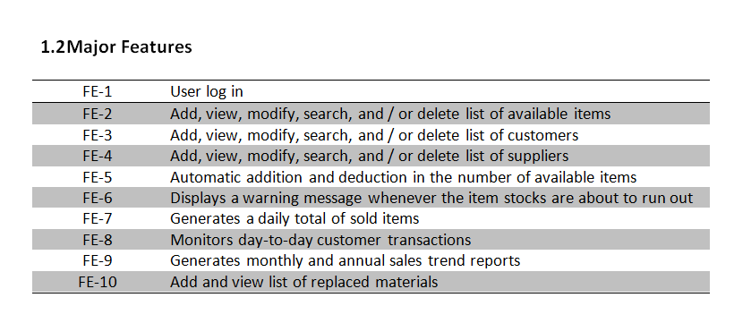

Slide 7
USE CASES
Look-up Item Availability
Purchase Item/s
Payment Details
Customer Records Update
Defective Items
Inventory Update
Sales Report

Slide 8
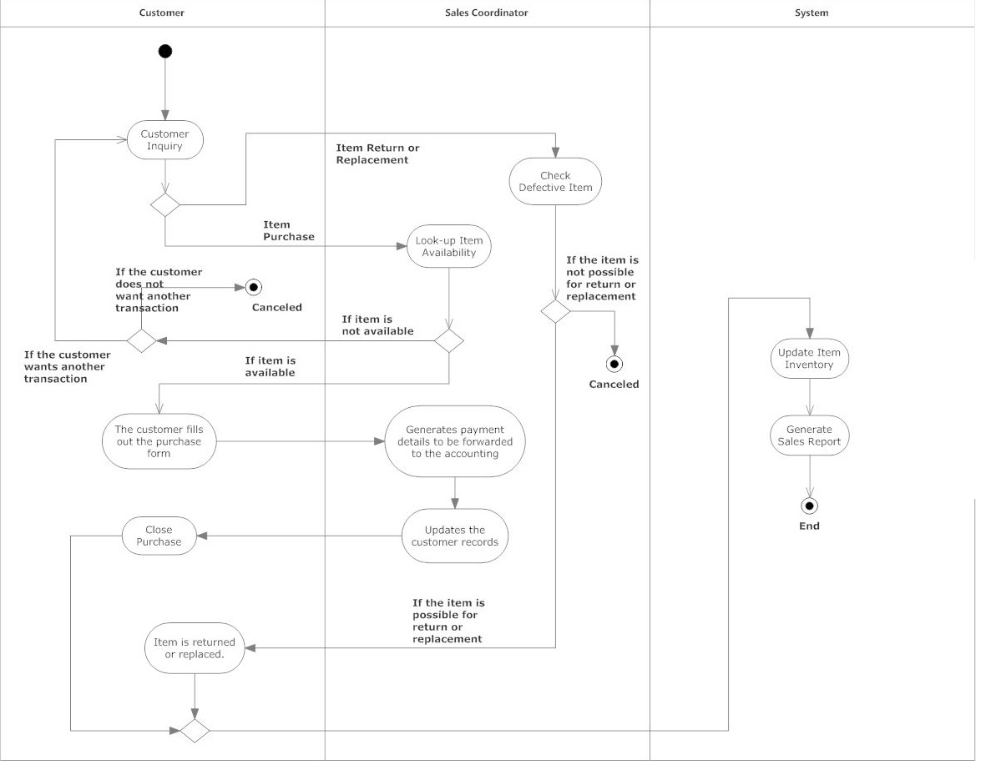
Activity Diagram

Slide 9
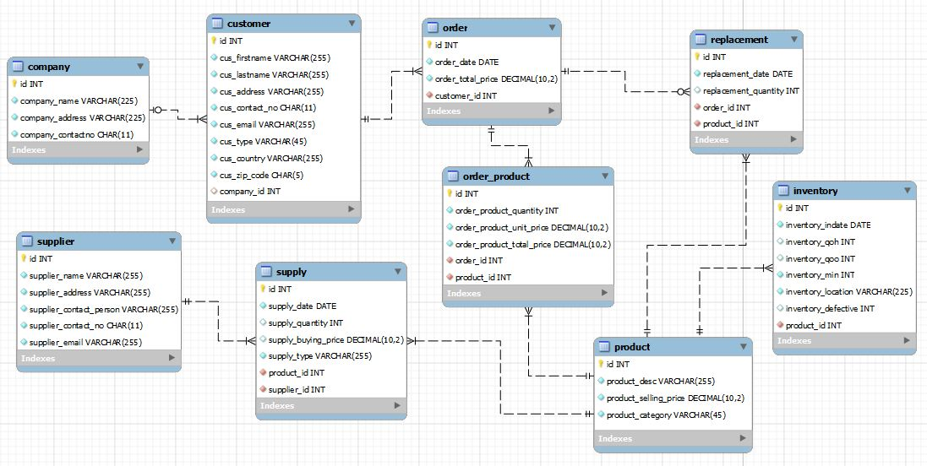
Entity Relationship Diagram

Slide 10
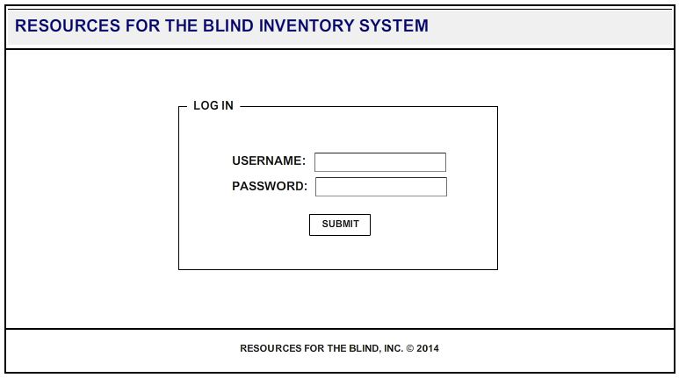
Screen Design

Slide 11
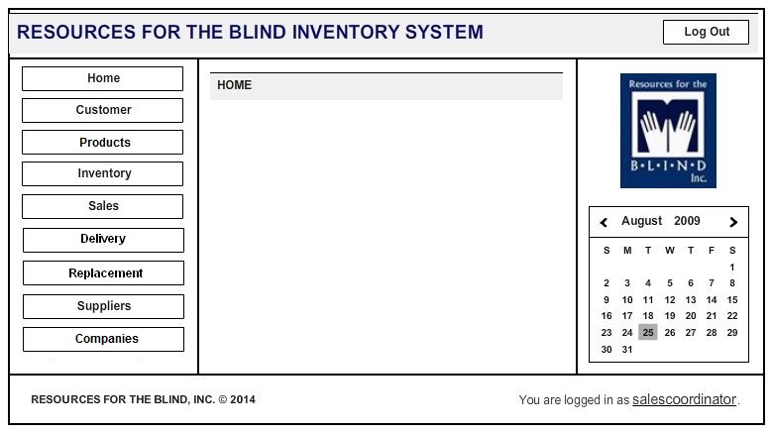

Slide 12
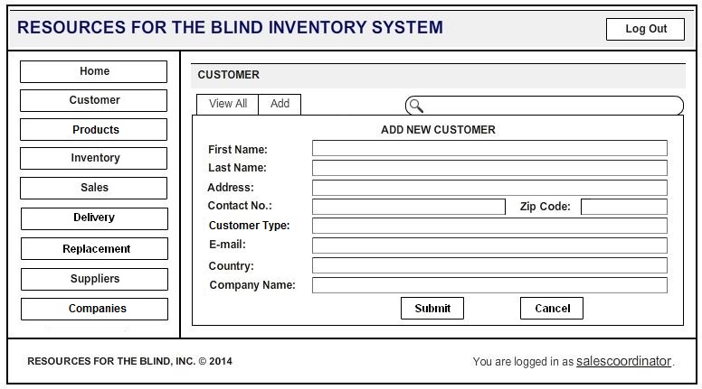

Slide 13
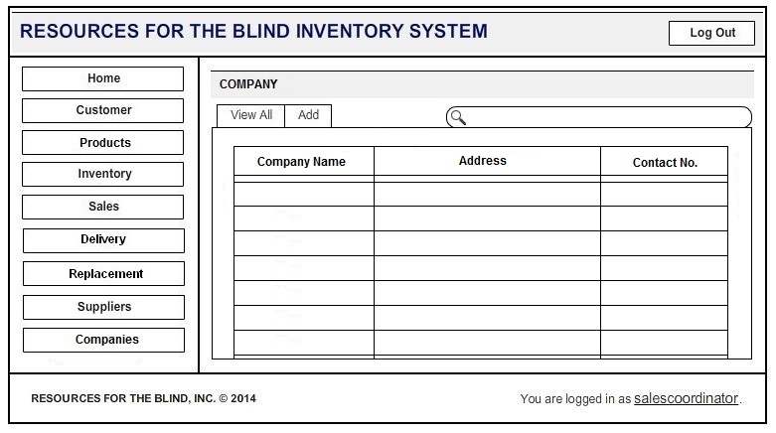

Slide 14
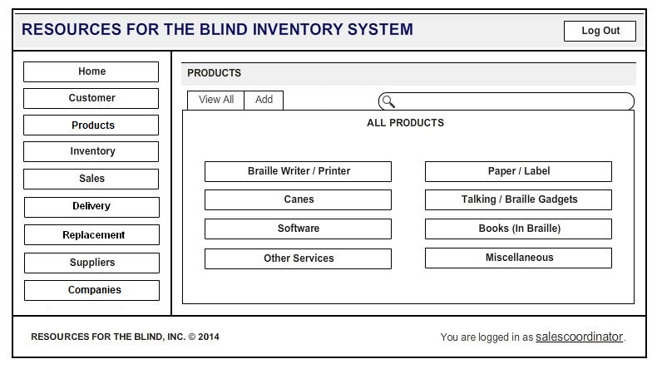

Slide 15
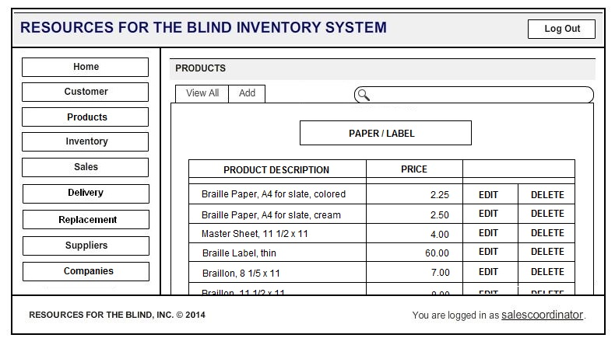

Slide 16
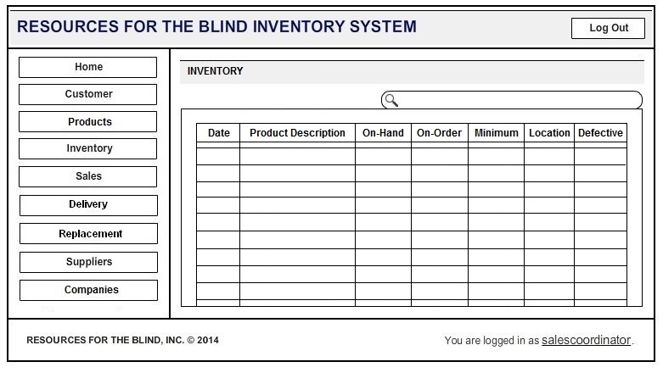

Slide 17
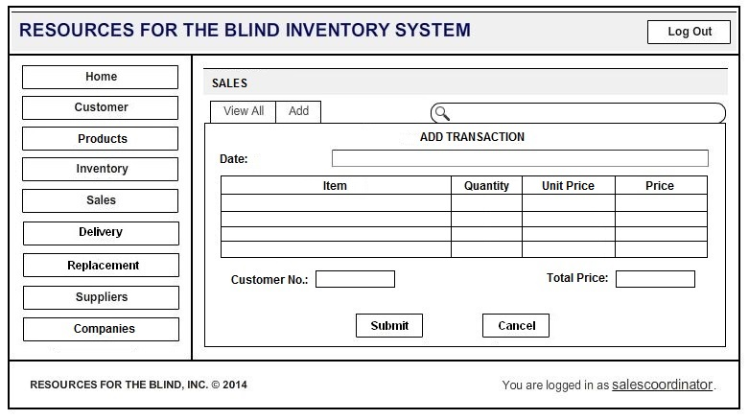

Slide 18
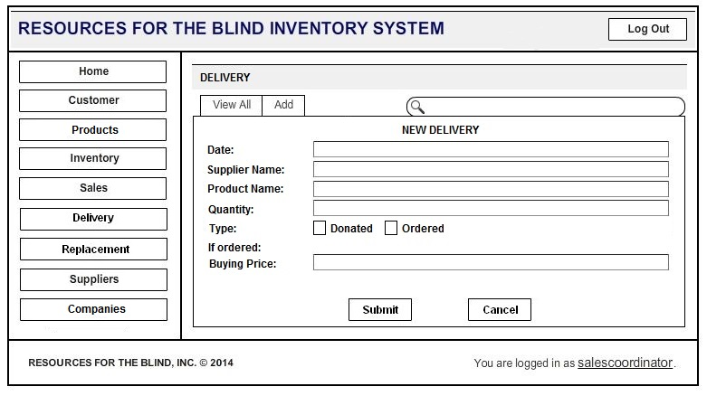

Slide 19
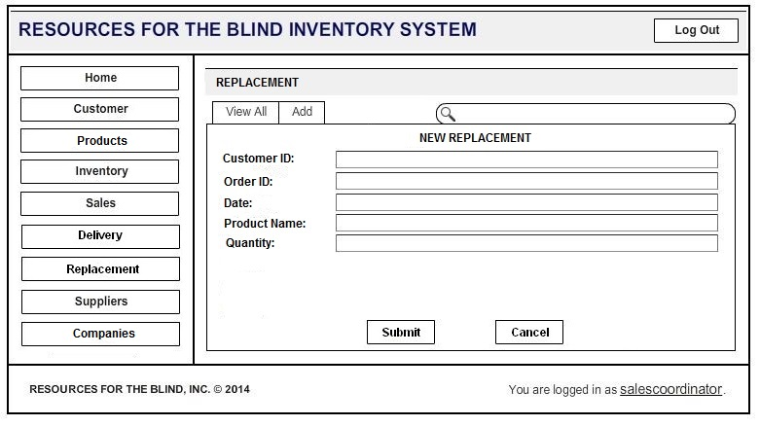

Slide 20
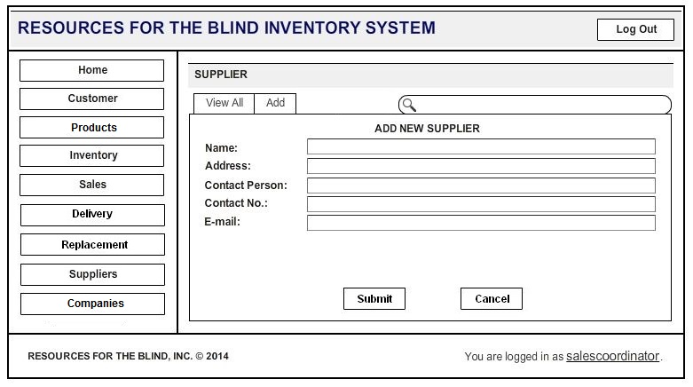

Slide 21
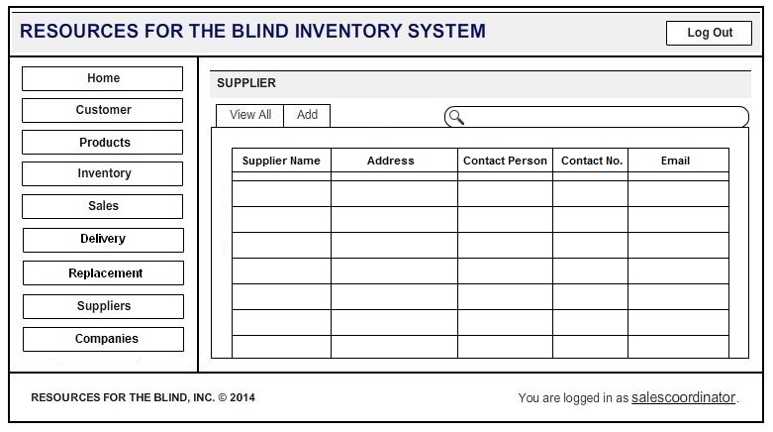

Slide 22
